Slide 1
PROBLEM SOLVING USING PROGRAMMING • JAVA
Course Registration
& Timetable Builder
A constraint-aware academic scheduling and enrollment concept mapped to the PSP (Java) handout
PROJECT TEAM
V. Mohith Kamal • Sairam Baruvuri • Samay Gupta
2620080012 2620080011 2620090116
2026–2027 | JAVA PROGRAMMING PROJECT
PSP (JAVA) • PROJECT–SYLLABUS ALIGNMENT
01

Slide 2
SECTION 02
ABSTRACT
The Course Registration and Timetable Builder is an integrated software platform designed to automate and streamline the academic registration process for educational institutions. Manual course selection and scheduling often suffer from time-slot clashes, room double-bookings, and complex credit limit violations.
By leveraging Object-Oriented Programming (OOP) principles in Java, this system incorporates automated constraint verification, real-time conflict detection, and schedule generation. The platform offers students an intuitive portal to construct clash-free timetables while empowering administrators with efficient resource allocation and real-time data persistence.

Slide 3
01 • PROJECT OVERVIEW
Understanding Problem Statement
From manual course selection to structured registration and timetable planning.
In educational institutions, course registration and timetable preparation are often challenging due to limited classroom availability, faculty schedules, course prerequisites, credit limits, and overlapping class timings. Manual scheduling can lead to timetable conflicts, registration errors, inefficient resource utilization, and increased workload for students and administrators.
The Course Registration & Timetable Builder aims to develop a Java-based system that simplifies course registration and automates timetable generation.. By organizing these processes systematically, the project aims to reduce manual effort, improve registration accuracy, utilize academic resources efficiently, and provide a smoother course selection experience for students and administrators.
Core idea: represent academic rules clearly, then use program logic to check them consistently.
PSP (JAVA) • PROJECT–SYLLABUS ALIGNMENT
02

Slide 4
03 • MODULE 1
Java foundations used to express the rules
These are the foundational concepts needed to turn the project rules into executable logic.
Variables & data types
Operators & expressions
Store IDs, credits, room numbers, time slots and status values.
Compare credits with limits; combine eligibility conditions with && and ||.
Console I/O
Algorithm & flowchart
Read sample registration details and print a clear confirmation.
Specify the order of validation and timetable checks before coding.
Example rule (illustrative): registration is eligible only when prerequisites are satisfied and selected credits do not exceed the allowed limit.
PSP (JAVA) • PROJECT–SYLLABUS ALIGNMENT
04

Slide 5
04 • MODULE 2
Selection and iteration: validating constraints
Conditional statements make decisions; loops repeatedly inspect courses, rooms and time slots.
SELECTION
ITERATION
if / else checks whether a student meets prerequisites, stays within the credit limit, or has a timetable clash.
for / while loops can examine every selected course and compare its time slot with other courses or available rooms.
Condition → decision → status message
Repeat checks until all records are reviewed
Alignment note: the project deck describes validation and conflict detection; the exact Java statements are implementation choices.
PSP (JAVA) • PROJECT–SYLLABUS ALIGNMENT
05

Slide 6
05 • MODULE 3
Methods, arrays and decomposition
Breaking the system into smaller operations improves clarity, testing and reuse.
validateStudent()
Checks student details and registration eligibility.
↓
checkPrerequisites()
Verifies that required earlier courses are completed.
↓
detectConflict()
Compares a course time slot against an existing schedule.
↓
generateTimetable()
Combines valid course, faculty, room and period assignments.
Arrays or lists can represent selected courses and available time slots; this is a suggested design mapping.
PSP (JAVA) • PROJECT–SYLLABUS ALIGNMENT
06

Slide 7
06 • MODULE 4
Object-oriented modelling is the clearest match
The uploaded project explicitly describes Java OOP architecture and academic entities.
Student
Course
Faculty
Room
studentId
name
selectedCourses
courseCode
credits
prerequisites
facultyId
availability
roomId
capacity
OOP concepts from the handout
Classes and objects model real academic entities.
Encapsulation protects fields and exposes controlled methods.
Constructors initialize objects; methods perform validation and scheduling tasks.
Relationships connect students, courses, faculty and rooms.
PSP (JAVA) • PROJECT–SYLLABUS ALIGNMENT
07

Slide 8
07 • MODULES 5 AND 6
Strings, persistence, collections and reports
These handout topics are useful extensions; the current project slides mention MySQL persistence but do not show their Java implementation.
MODULE 5 • STRINGS & FILE I/O
MODULE 6 • COLLECTIONS & STREAMS
Parse course codes and registration records
List / ArrayList for course selections
Validate text fields and compare identifiers
Map for lookup by course or student ID
Generate text reports or import/export records
Set to avoid duplicate registrations
Handle missing or malformed input safely
Streams for filtering courses and summarizing reports
Persistence distinction: the uploaded architecture names a relational MySQL database; file I/O is an optional handout-aligned extension.
PSP (JAVA) • PROJECT–SYLLABUS ALIGNMENT
08

Slide 9
02 • WORKFLOW
Input → Process → Output
The IPO model connects Module 1 problem-solving to the project workflow.
INPUT
PROCESS
OUTPUT
Student ID and selected courses
Validate registration rules
Registration status
→
→
Course prerequisites and credits
Detect overlapping time slots
Personal timetable
Faculty availability, rooms, time slots
Apply constraints and generate schedule
Conflict and resource reports
Algorithmic thinking: decompose registration, validation, conflict checking and timetable generation into smaller steps.
PSP (JAVA) • PROJECT–SYLLABUS ALIGNMENT
03

Slide 10
PROJECT OUTCOME / 11
Conclusion
The Course Registration & Timetable Builder provides a structured approach to course selection and timetable preparation. By validating prerequisites, credit limits, time-slot clashes, and resource availability, the project can reduce manual effort and improve the accuracy of academic planning.
ACCURATE • EFFICIENT • ORGANIZED
FUTURE ENHANCEMENTS
Actual Java class implementation • Exception-safe validation • Database operations • Testing and reports
PSP (JAVA) • COURSE REGISTRATION & TIMETABLE BUILDER 11

Slide 11
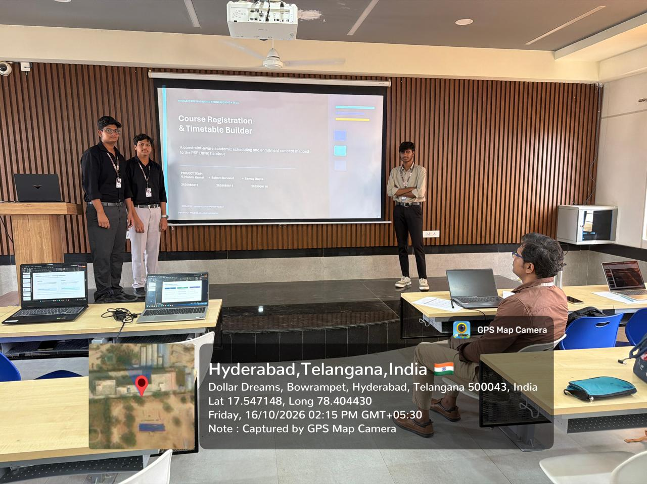
Geo Tag Photo and Github Link
https://github.com/MOHIITHKAMAL/COURSE-REGISTRATION-TIMETABLE-BUILDER..

Slide 12
PSP (JAVA) • PROJECT PRESENTATION
Thank You
Course Registration & Timetable Builder
V. Mohith Kamal • Sairam Baruvuri • Samay Gupta
PSP (JAVA) • COURSE REGISTRATION & TIMETABLE BUILDER 12

